Slide 1
Analysis of Gender Discrimination Lawsuit
Analytics consultant for the female doctors

Slide 2
Content
Descriptive statistics & Linear Regression
Logistic Regression
CART Models

Slide 3
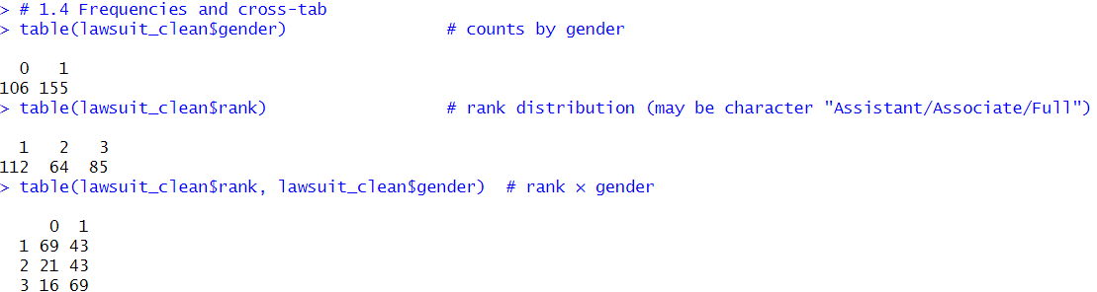
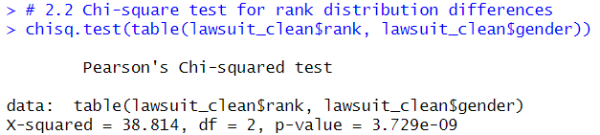
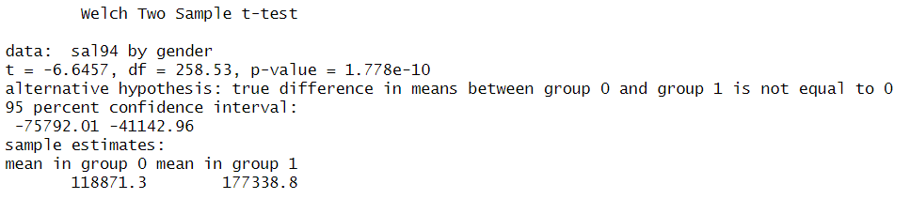
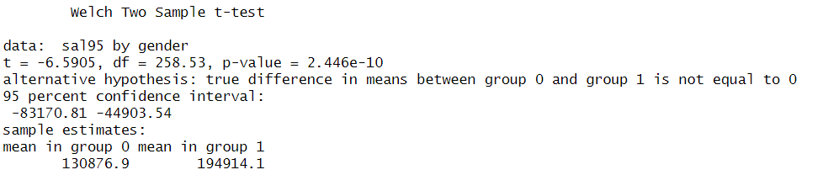
Descriptive statistics
Cross table
Chi-square Test on Rank Distribution
Hypothesis: H0: Rank distribution is independent of gender. H1: Rank distribution is associated with gender. Result: Chi-squared = 38.814, df = 2, p-value < 0.0001. Reject H0 → Rank distribution differs significantly by gender.
Women are more concentrated in lower ranks.
The proportion of women decreases as rank increases.
This indicates that women have significantly fewer opportunities for promotion to senior ranks.
T-tests
In both 1994 and 1995, women earned significantly less than men, with the pay gap widening over time — clear evidence of potential gender discrimination.

Slide 4
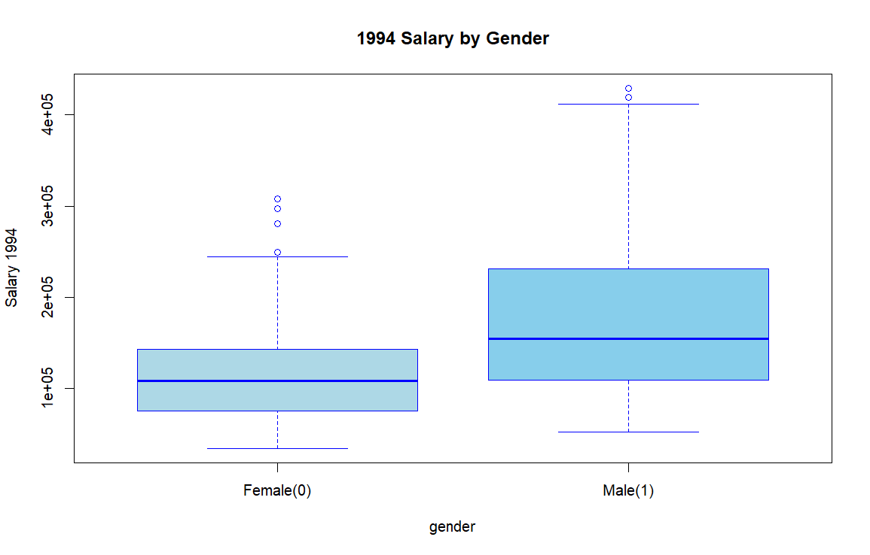
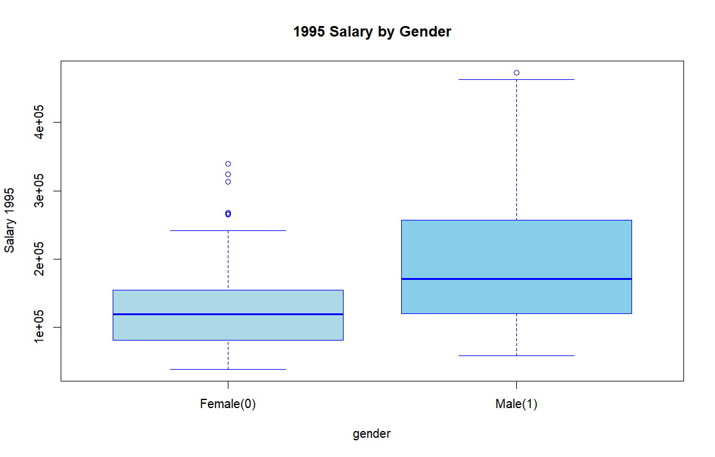
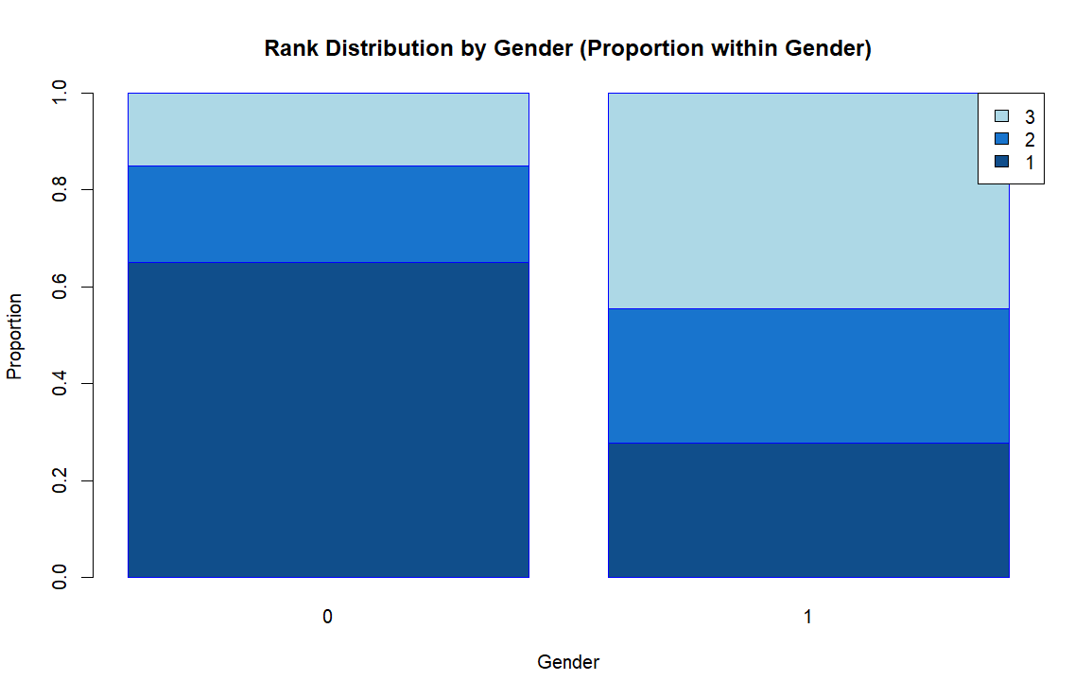
Visualization
Salary Boxplot by Gender
Rank Distribution by Gender
Women are concentrated at lower ranks (Assistant Professors).
The proportion of women decreases sharply at higher ranks.
Men dominate at the Full Professor level.
Strong evidence of unequal promotion opportunities.
Female salaries are consistently lower than male salaries.
Median salary for women is significantly below that of men.

Slide 5
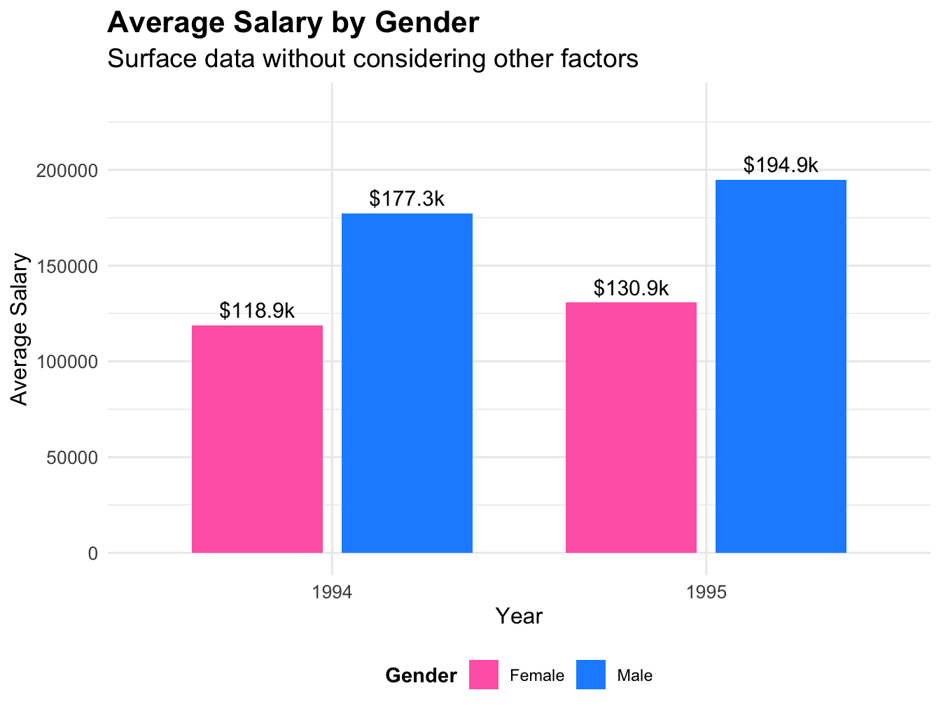
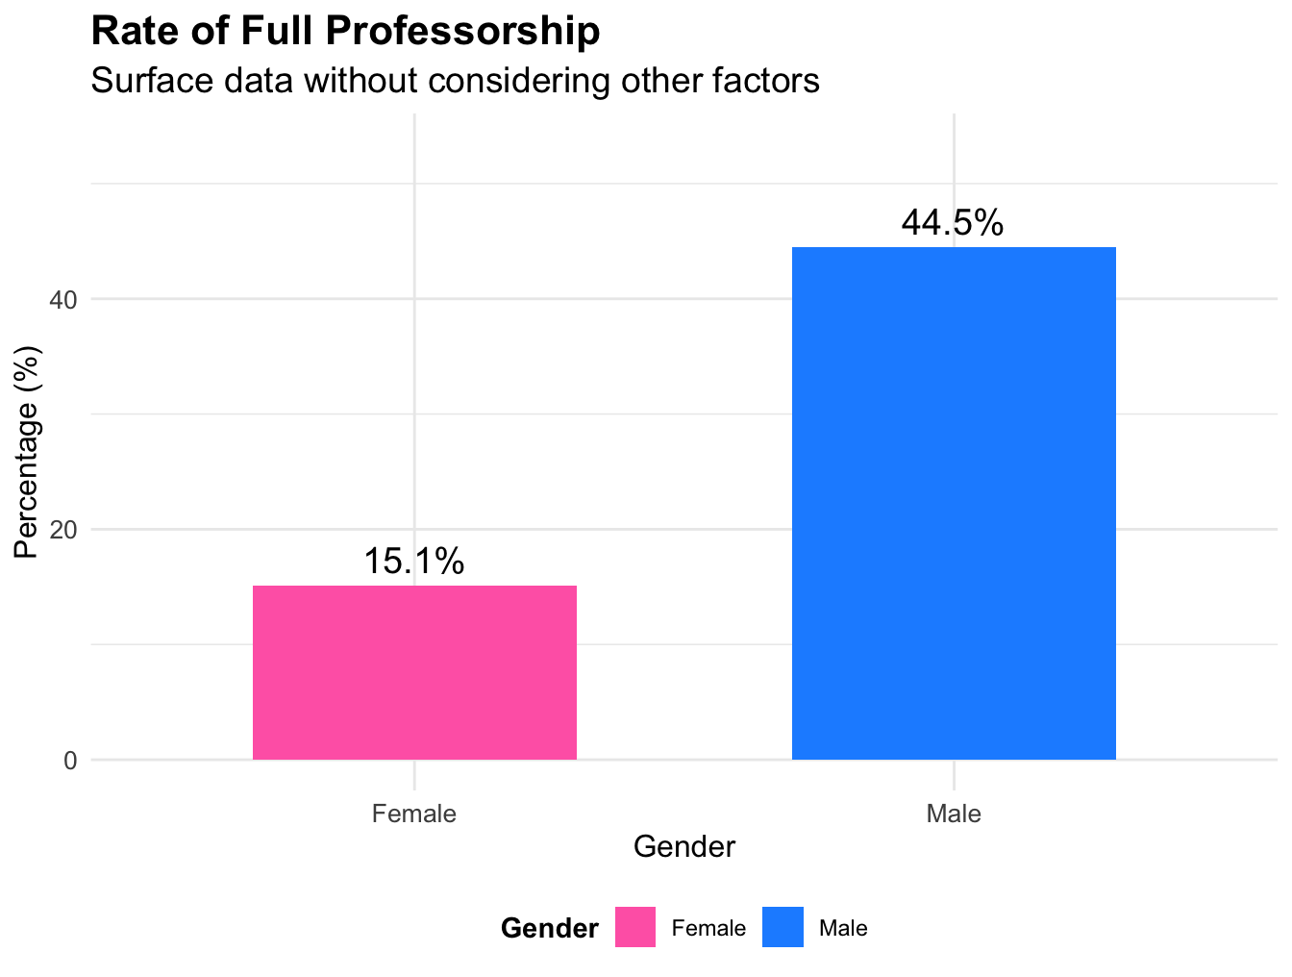
Linear Regression: What do we see, when we DONT consider other factors?
Salary difference:
Men's salaries are significantly higher than women's.
Promotion difference:
Men are more likely to become full professors.

Slide 6
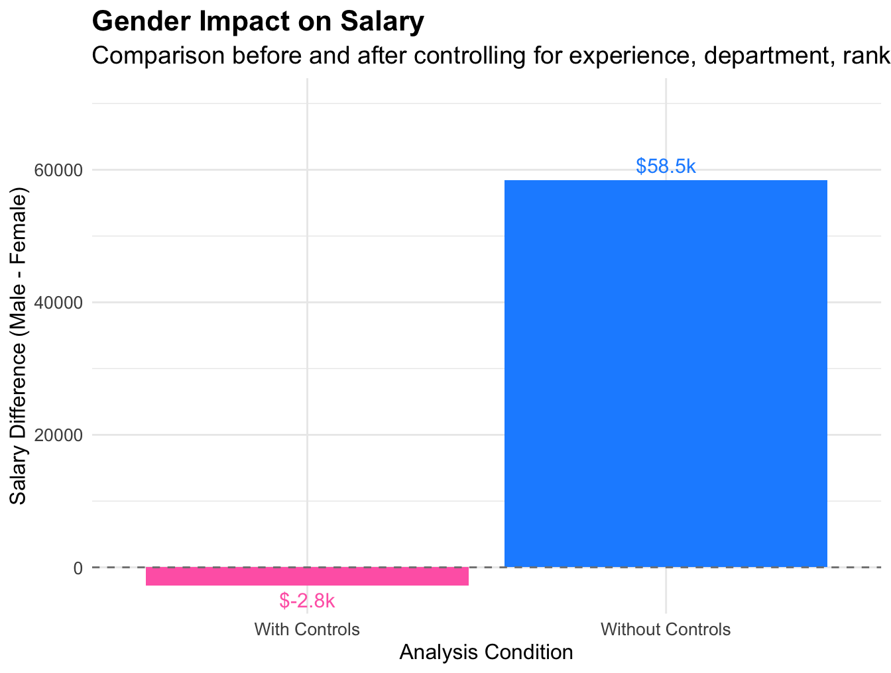
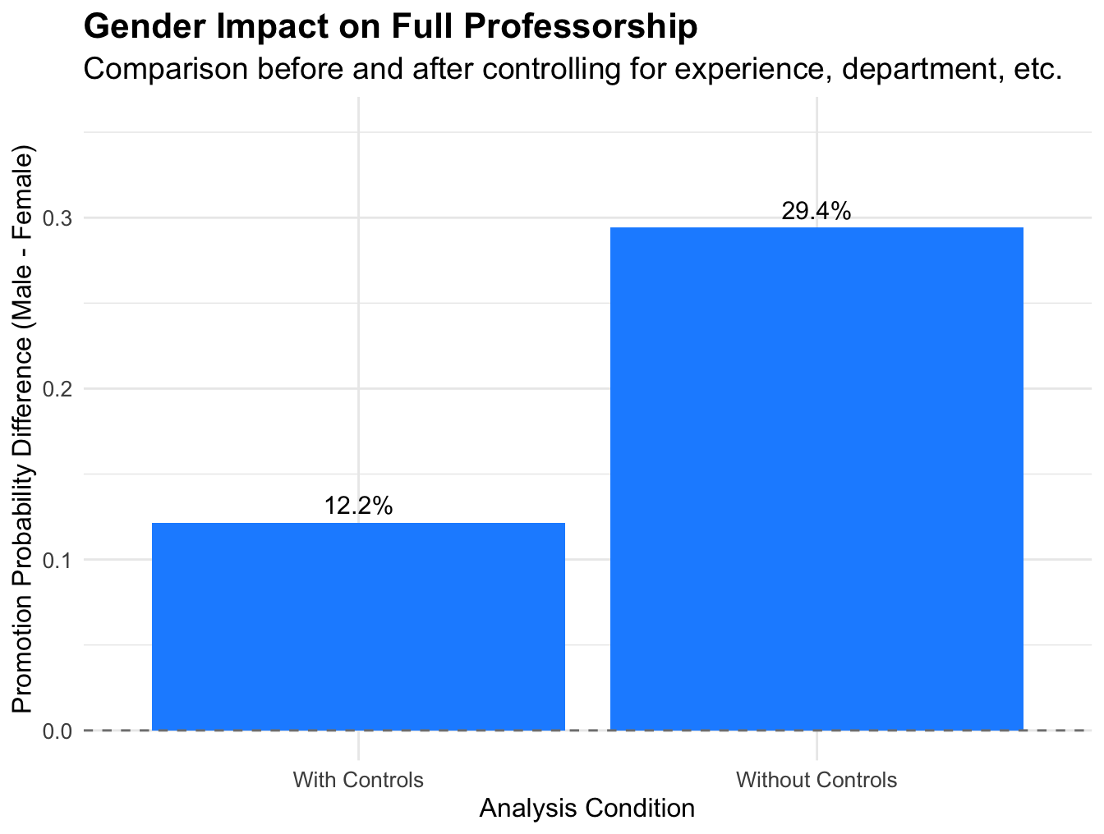
Linear Regression: What is the truth, after excluding confounding factors?
Salary Gap: Elimated
Promotion Gap: Persists

Slide 7
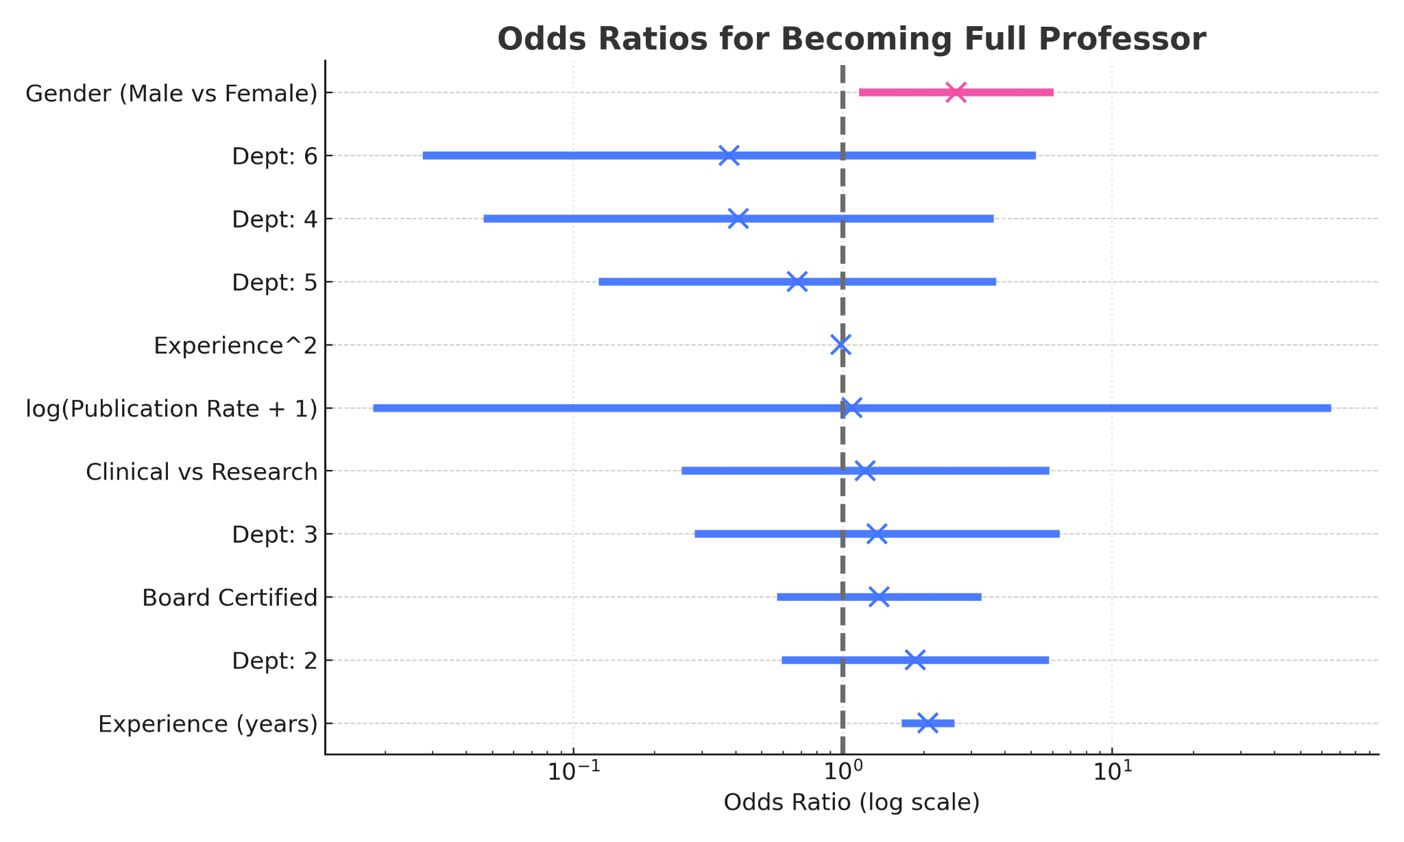
Logistic Regression: Gender Lowers the Odds of Becoming Full Professor
Key Points
Male vs Female: OR = 2.64
(95% CI 1.15–6.06, p = 0.022).
Interpretation: At comparable credentials and within the same departments, men have higher odds of attaining Full Professor.
Other controls behave as expected
(e.g more experience → higher odds).
Model: Logit(FullProf=1). Controls: Dept FE, Clin, Cert, log(PubRate+1), Experience, Experience².
Data: Gender Discrimination Lawsuit Course Dataset.

Slide 8
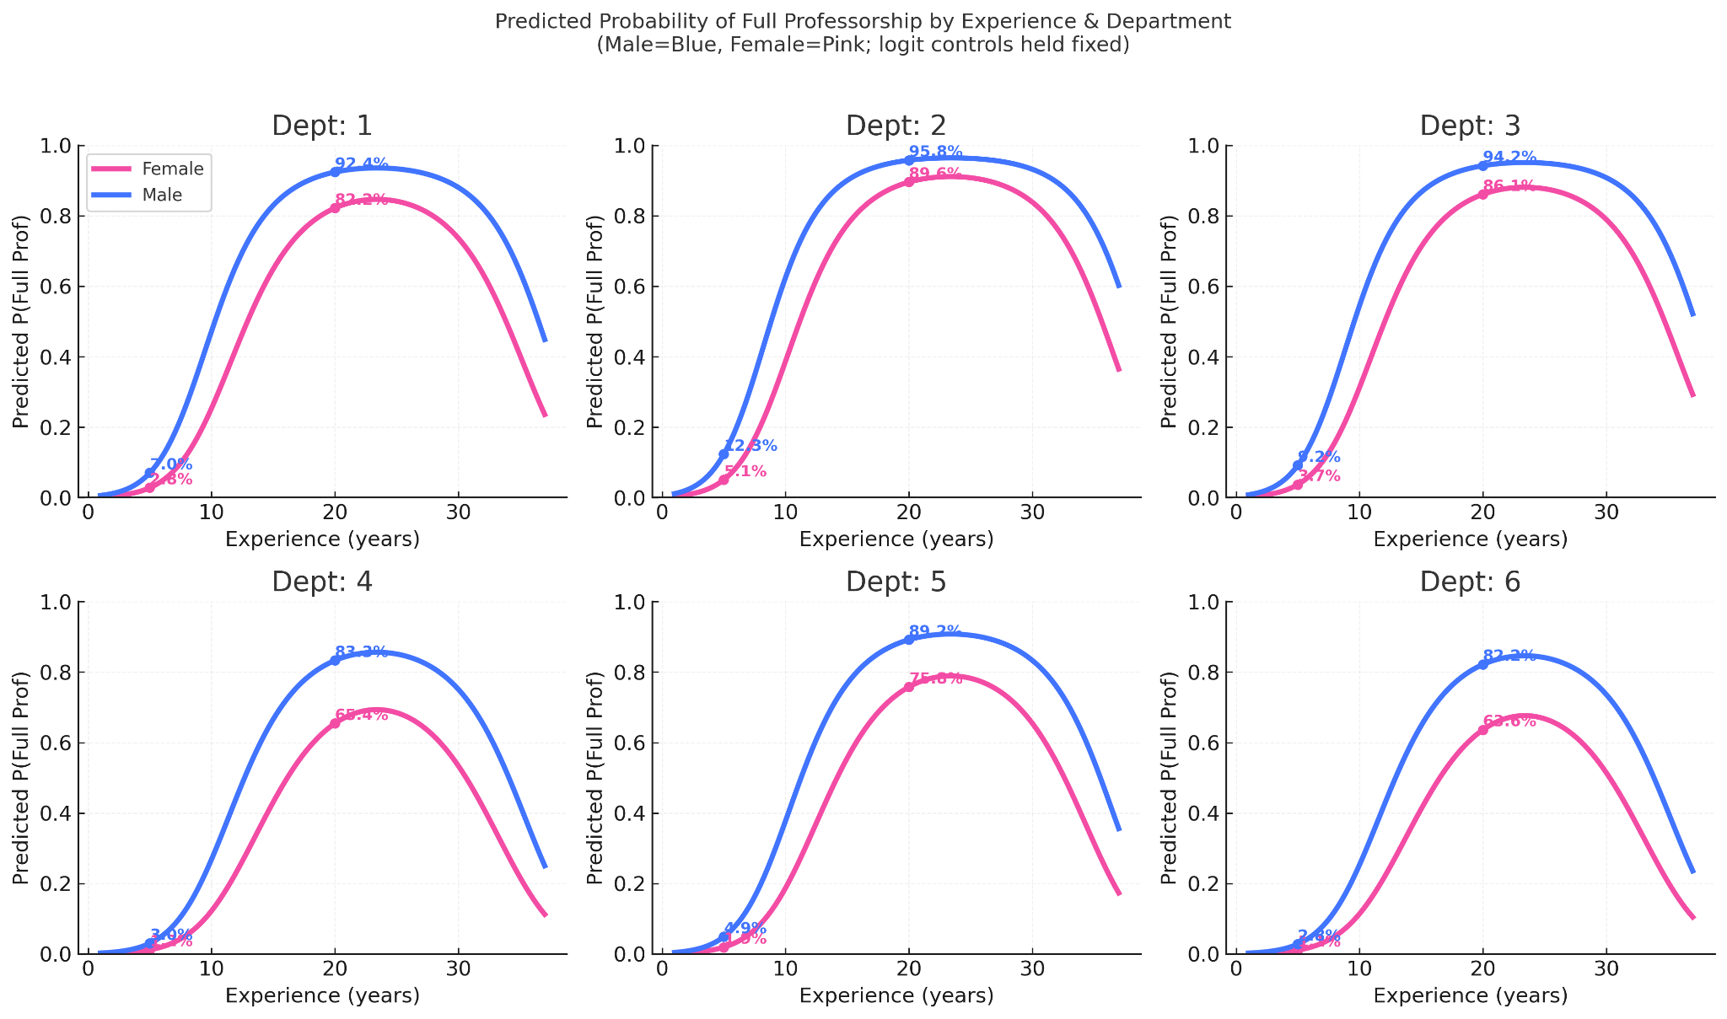
Logistic Regression: Predicted Probability of Full Professorship by Experience & Department
Key Points
Within the same department and similar credentials, the Female curve lies below the Male curve across the experience range.
Representative panels (fixed at median publication rate, Clinical=Yes, Certified=Yes)
eg: Dept 5 — 5 yrs: Female 1.9% vs Male 4.9%; 20 yrs: Female 75.8% vs Male 89.2%.
Holding log(Publication Rate+1) at median, Clinical role = Clinical, Certification = Cert

Slide 9
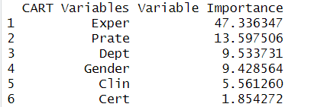
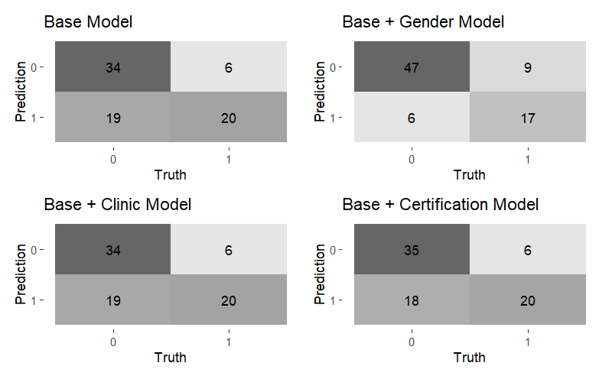
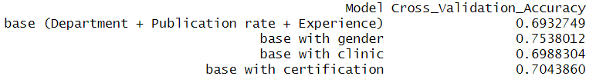
CART Model: Compare Gender and Other Variables
CART Model on Predicting Full Professorship
Confusion Matrices on Predicting Full Professorship using Test Set (79 Instances)
Gender has more impact than the factors of clinical emphasis and board certification on predicting an individual’s rank.
This conclusion is reinforced by the cross-validation training accuracies and prediction accuracies of 4 different CART models. The model including gender has the highest accuracies.
10-Fold Cross-validation Accuracies on Predicting Full Professorship using Training Set (182 Instances)

Slide 10
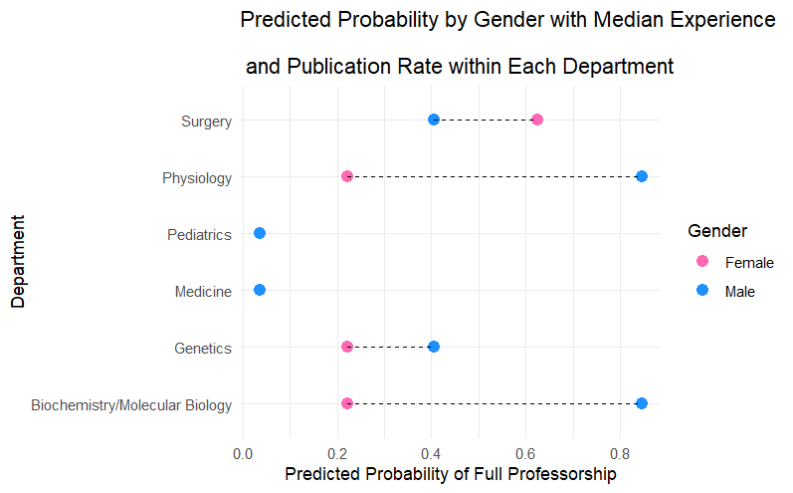
CART Model: Predicted Probabilities of Full Professorship by Gender and Department
This plot uses a CART model including 4 variables: department, experience, publication rate and gender. It has a cross-validation accuracy of 75.4%.
Interpretation:
Among 6 departments, there are 3 departments where female doctors having a median experience and publication rate are predicted to have a lower probability of being full professors than their male counterparts.
Even in the only department (Surgery) where females seem to have an advantage over males in promotion, both probabilities are around 0.5 and thus not a prominent difference. While in the department of Biochemistry and Physiology, there exists a hopelessly huge gap between the probabilities by gender.

Slide 11
Conclusion
One-sentence takeaway:
We find a systematic promotion disadvantage for women. After controlling for experience, publication output, role, and department differences, men are more likely to become Full Professors; this unequal “promotion gate” is the key driver of long-run pay inequality.
Key Evidence:
Descriptive & Linear Models: Women are over-represented in lower ranks; raw pay is lower for women, and while observed factors explain much of the current pay gap, the promotion gate remains unequal.
Logistic Regression: Male vs Female OR = 2.64 → at comparable credentials and within the same departments, men are significantly more likely to reach Full Professor.
CART: Adding Gender yields the highest CV and test accuracy; splits/importance repeatedly single out Gender → results align with the logit and visuals.
Implication: The promotion process—not just current pay—drives inequality. Remedy: Transparent promotion criteria, periodic equity audits, and oversight to remove structural bias.

Slide 12
Thanks

